Slide 1
Installing and Configuring IIS

Slide 2
Feature Description
Reliable IIS 6.0 uses a new request-processing architecture and application-isolation environment that enables individual Web applications to function within a self-contained worker process. This environment prevents one application or Web site from stopping another, and reduces the amount of time administrators spend restarting services to correct problems related to applications. The new environment also includes proactive application health monitoring.

Slide 3
Hardware Requirements
Microsoft Windows Server 2003 Web Edition
Processor: 133-MHz processor (550 MHz recommended)
Memory: 128 MB RAM (256 MB recommended; 2 GB max)
Hard disk space: 1.2 GB for network install; 2.9 GB for CD install
Windows Server 2008
Processor: 1 GHz/1.4 GHz (2 GHz recommended)
Memory: 512 MB (2 GB recommended; 2 TB max)
Hard disk space: 10 GB (40 GB recommended)
DVD drive

Slide 4
Installing Additional Components

Slide 5
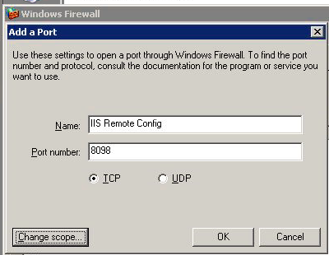
Windows Firewall for Remote Web Administration
Must enable TCP port 8098 & 8099

Slide 6
Default Document
You can configure the default document settings for the Web site or folder.
You can specify more than one default document for a Web site or folder.
IIS searches for and serves default documents in the order in which they are listed and returns the first document that it finds.
If no match is found and folder browsing is activated for that site or folder, IIS returns a folder listing.
If folder browsing is not activated, IIS returns an "HTTP Error 403 - Forbidden" message to the browser.
Examples of default document names include Default.htm, Default.asp, Index.htm, and Index.html

Slide 7
How to Configure the Default Document
Start Internet Services Manager, or start the Microsoft Management Console (MMC) that contains the IIS snap-in.
Right-click the Web site, virtual folder, or folder whose default document settings you want to configure, and then click Properties.
Click the Documents tab.
Click to select the Enable Default Document check box. This turns on default document handling for the Web site, virtual folder, or folder that you selected.
To add a new default document:
Click Add.
In the Default Document Name box, type the name of the default document that you want to add (for example, type Index.htm), and then click OK.
NOTE: Make sure that the name of the new default document that you add matches the name of the actual default document file. Also, make sure that the file exists in the appropriate content folder on the Web site.
To change the search order priority, click the document that you want to move, and then click the Up or Down button to move the document to the position in the list that you want.
To remove a default document, click the document that you want to remove, and then click Remove.8.Click OK, and then quit Internet Services Manager, or the IIS snap-in.

Slide 8
Configuring Web Server using IIS Manager

Slide 9
Web Site Properties

Slide 10
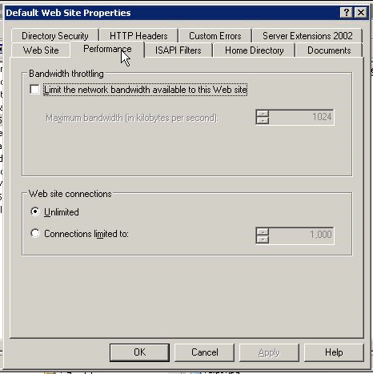

Slide 11
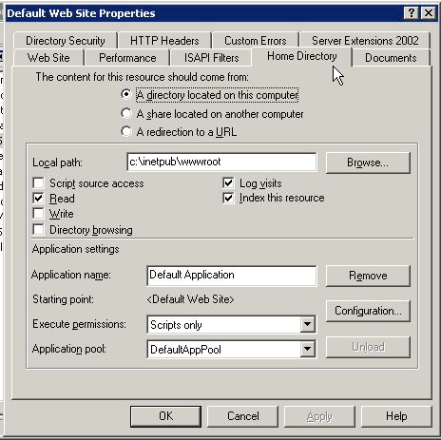

Slide 12
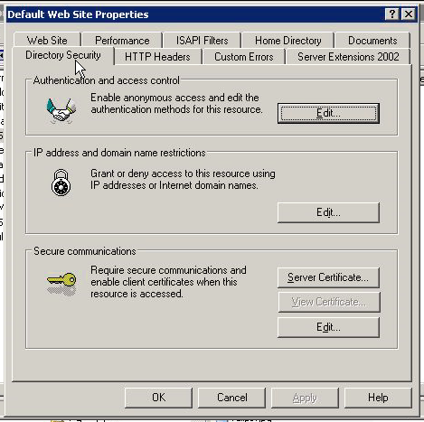

Slide 13
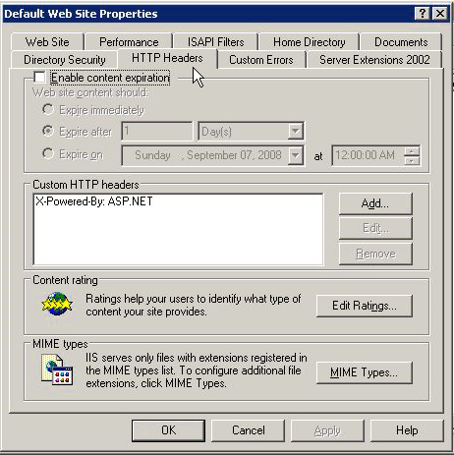

Slide 14
IIS Metabase Configuration File
In IIS 6.0, the metabase is stored in two plain-text XML files.
Since these are plain text, it is a fairly straightforward process to edit the configuration and schema data using most any commonly available text-editing tools.
Import, export, backup, and restoration procedures for the database all become easier, as well.
Found in the \%system%\system32\inetsrv folder
MetaBase.xml and MBSchema.xml
Whenever changes are made through the Internet Services Manager (ISM), these changes are first written to the in-memory metabase and then to the MetaBase.xml file either after a set period of time or after a specific number of changes.
Another new feature of the IIS metabase is automatic versioning and history.
Open up the Internet Information Services Manager
Right-click on the computer name and select Properties.
Turn the Enable Direct Metabase Edit

