Slide 1
Chapter 11
Introduction to PHP

Slide 2
What is PHP?
It is a Web development language written by and for Web developers
PHP stands for PHP: Hypertext Preprocessor
Originally called Personal Home Page Tools
Executable files can have extensions of .PHP, .PHP3, .PHTML
Currently in its 5th major rewrite called PHP5
It is a server-side scripting language, which can be embedded in HTML or used as a standalone executable.

Slide 3
Other benefits of PHP
Embedded in HTML making it easier to reuse code generated by others or web development apps
Cross-platform. Can run on Linux, Solaris, BSD, AIX, SCO, HP-UX, Mac OS-X, Windows, and more. Integrates with Apache, Netscape server, IIS, PWS, Omni web servers.
Not tag-based (like ColdFusion)
It’s stable (unlike ASP)
Server doesn’t have to be rebooted often (even after an upgrade)
Software doesn’t normally change radically and is backward-compatible
It’s zippy (unlike CGI or Can’t Go Instantly)
Works well for processing form data
Plays well with others (currently integrates support for at least 15 RDBMSs + ODBC and many Internet protocols)
Can be encrypted so applications can be sold to other parties who won’t be able to “reverse engineer” your code.

Slide 4
11.2 Overview of PHP
When a PHP document is requested of a server, the server will send the document first to a PHP processor
The result of the processing is the response to the request
Two modes of operation
Copy mode in which plain HTML is copied to the output
Interpret mode in which PHP code is interpreted and the output from that code sent to output
The client never sees PHP code, only the output produced by the code
PHP has typical scripting language characteristics
Dynamic typing, untyped variables
Associative arrays
Pattern matching
Extensive libraries

Slide 5
11.3 General Syntactic Characteristics
PHP code is contained between the tags <?php and ?>
Code can be included with the PHP include
Include(“table2.inc”);
When a file is included, the PHP interpreter reverts to copy mode
Thus, code in an include file must be in <?php and ?> tags
All variable names in PHP begin with $ and continue as usual for variables
Variable names are case sensitive
However keywords and function names are not case sensitive

Slide 6
Escaping from HTML
PHP is embedded within HTML
Anything that is compatible with HTML on the client side is also compatible with PHP
You can use any method of developing Web pages (with the caveats mentioned earlier), and simply add PHP to that
In order to tell the PHP parser how to recognize where your PHP code begins and ends you need to “escape” from HTML (like the <SCRIPT> tags for JavaScript)
4 styles of PHP tags
Canonical PHP tags (most universal): <?php … ?>
Short-open (SGML-style): <? … ?>
ASP-style: <% … %>
HTML script tags: <SCRIPT LANGUAGE=“PHP”> … </SCRIPT>
Notes:
May need to modify the php.ini file to enable alternative PHP tags.

Slide 7
Hello world
Open a new file in your PHP editor (e.g. notepad)
<HTML>
<HEAD>
<TITLE>My first PHP program</TITLE>
</HEAD>
<BODY>
<?php
print(“Hello, cruel world<BR><BR>\n”);
phpinfo();
?>
</BODY>
</HTML>

Slide 8
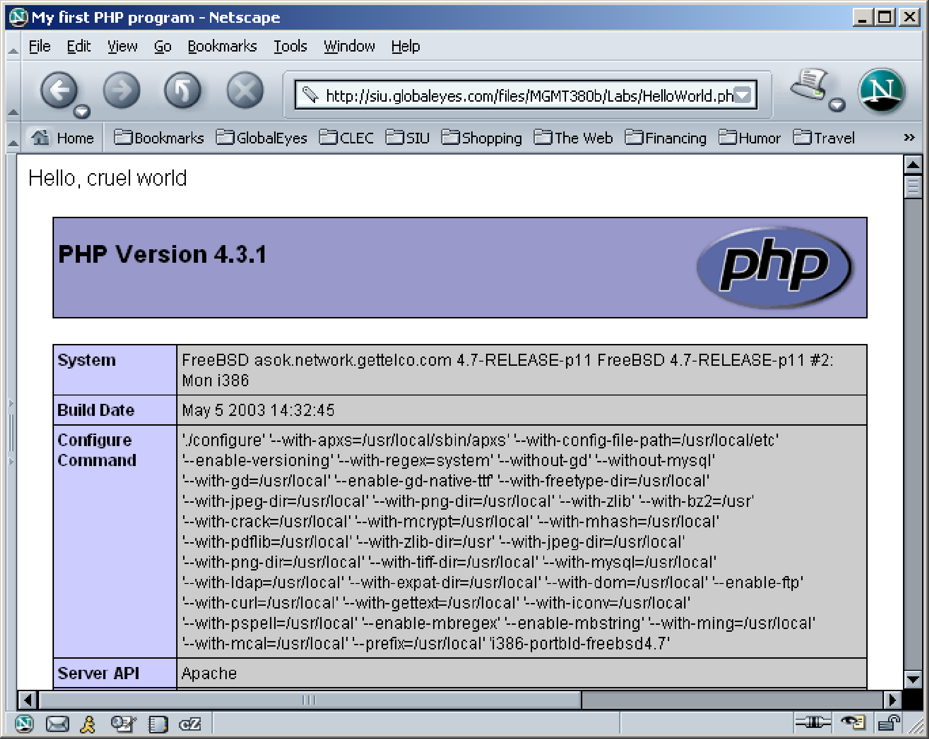
Hello World - output

Slide 9
11.3 PHP Syntax
One line comments can begin with # or // and continue to the end of the line
Multi-line comments can begin with /* and end with */
PHP statements are terminated with semicolons
Curly braces are used to create compound statements
Variables cannot be defined in a compound statement unless it is the body of a function

Slide 10
11.4 Primitives, Operations, Expressions
Four scalar types: boolean, integer, double, string
Two compound types: array, object
Two special types: resource and NULL

Slide 11
11.4 Variables
Variables are not declared except in order to specify scope or lifetime
A variable that has not been assigned a value is unbound and has the value NULL
NULL is coerced to 0 if a number is needed, to the empty string if a string is needed
Both of these coercions count as boolean FALSE
The error_reporting function is used to set the level of problems that will be reported
For example, level 15 includes reporting unbound variable errors

Slide 12
11.4 Integer Type
PHP distinguishes between integer and floating point numeric types
Integer is equivalent to long in C, that is, usually 32 bits

Slide 13
11.4 Double Type
Literal double type numeric values include a period and/or the exponent sign: either e or E
Double type values are stored internally as double precision floating point values

Slide 14
11.4 String Type
Characters in PHP are one byte
String literals are enclosed in single or double quotes
Double quoted strings have escape sequences interpreted and variables interpolated
Single quoted strings have neither escape sequence interpretation nor variable interpolation
A literal $ sign in a double quoted string must be escaped with a backslash, \
Strings can cover multiple lines, the included end of line characters are part of the string value

Slide 15
11.4 Boolean Type
The boolean type has two values :TRUE and FALSE
Other type values are coerced as needed by context, for example, in control expressions
The integer value 0, the empty string and the literal string “0” all count as false
NULL counts as false
The double value 0.0 counts as false. Beware, however, that double calculations rarely result in the exact value 0.0

Slide 16
11.4 Arithmetic Operators and Expressions
PHP supports the usual operators supported by the C/C++/Java family
Integer divided by integer results in integer if there is no remainder but results in double if there is a remainder
12/6 is 2
12/5 is 2.4
A variety of numeric functions are available: floor, ceil, round, srand, abs, min, max

Slide 17
11.4 String Operations
String catenation is indicated with a period
Characters are accessed in a string with a subscript enclosed in curly braces
Many useful string functions are provided
strlen gives the length of a string
strcmp compares two strings as strings
rtrim/chop removes whitespace from the end of a string

Slide 18
11.4 Scalar Type Conversions
Implicit type conversions as demanded by the context in which an expression appears
A string is converted to an integer if a numeric value is required and the string has only a sign followed by digits
A string is converted to a double if a numeric value is required and the string is a valid double literal (including either a period or e or E)
Type conversions can be forced in three ways
(int)$sum in the C style
intval($sum) using several conversion functions
settype($x, “integer”)
Type can be determined with the gettype, is_int and similar functions for other types

Slide 19
11.4 Assignment Operators
The assignment operators used in C/C++/Java are supported in PHP

Slide 20
11.5 Output
The print function is used to send data to output
print takes string parameters, PHP coerces as necessary
The C printf function is also available
The first argument to printf is a string with interspersed format codes
A format code begins with % followed by a field width and a type specifier
Common types specifiers are s for string, d for integer and f double
Field width is a single integer to specify the number of characters (minimum) used to display the value or two integers separated by a period to indicate field width and decimal places for double values
printf(“x = %5d is %s\n”, $x, $size);
Displays $x as an integer and $size as a string
The example today.php uses the date function to dynamically generate a page with the current date

Slide 21
11.6 Relational Operators
PHP has the usual comparison operators: >, < <=, >=, == and !=
PHP also has the identity operator ===
This operator does not force coercion
The regular comparisons will force conversion of values as needed
Comparing a string with a number (other han with ===) will result in the string converting to a number if it can be. Otherwise the number is converted to a string
If two strings are compared (other than with ===) and the strings can both be converted to numeric values, the conversion will be done and the converted values compared
Use strcmp on the strings if the latter feature is a problem

Slide 22
11.6 Boolean Operators
PHP supports &&, || and ! as in C/C++/Java
The lower precedence version and and or are provided
The xor operator is also provided

Slide 23
11.6 Selection Statements
PHP provides an if with almost the same syntax as C/C++/Java
The only difference is the elseif (note, not elsif as in Perl)
The switch statement is provided with syntax and semantics similar to C/C++/Java
The case expressions are coerced before comparing with the control expression
break is necessary to prevent execution from flowing from one case to the next

Slide 24
11.6 Loop Statements
PHP provides the while, for, foreach, and do-while as in JavaScript
The for loop is illustrated in the example powers.php
This example also illustrates a number of mathematical functions available in PHP

Slide 25
11.7 Arrays
Arrays in PHP combine the characteristics of regular arrays and hashes
An array can have elements indexed numerically. These are maintained in order
An array, even the same array, can have elements indexed by string. These are not maintained in any particular order
The elements of an array are, conceptually, key/value pairs

Slide 26
11.7 Array Creation
Two ways of creating an array
Assigning a value to an element of an array
Using the array function
Create a numerically indexed array
array(23, ‘xiv’, “bob”, 777);
Create an array with string indexes
array(“x” => “xerxes”, “y” => “ytrbium”)

Slide 27
11.7 Accessing Array Elements
Array elements are accessed by using a subscript in square brackets
An array can be assigned to a list of variables
list($x, $y, $z) = array($y, $z, $x)

Slide 28
11.7 Functions for Dealing with Arrays
The unset function can be used to remove an array or an element of an array
The array_keys function returns a list of the keys of an array
The array_values returns a list of values in an array
The array_key_exists function returns true if a given key is actually present in a given array
is_array determines if its argument is an array
implode converts an array of strings to a single string, separating the parts with a specified string
explode converts a string into a list of strings by separating the string at specified characters

Slide 29
11.7 Sequential Access to Array Elements
PHP maintains a marker in each array, called the current pointer
Several functions in PHP manipulate the current pointer
The pointer starts at the first element when the array is created
The next function moves the pointer to the next element and returns the value there
The each function move the pointer to the next element and returns the key/value pair at the previous position
The key and value can be accessed using the keys “key” and “value” on the key/value pair
Both functions return false if no more elements are available
prev moves the pointer back towards the beginning of the array
reset moves the pointer to the beginning of the array

Slide 30
11.7 Arrays as Stacks
PHP provides the array_push function that appends its arguments to a given array
The function array_pop removes the last element of a given array and returns it

Slide 31
11.7 Iterating Through an Array
The foreach statement has two forms for iterating through an array
foreach (array as scalar_variable) loop body
foreach (array as key => value) loop body
The first version assigns each value in the array to the scalar_variable in turn
The second version assigns each key to key and the associated value to value in turn
In this example, each day and temperature is printed
$lows = array("Mon" => 23, "Tue" => 18, "Wed" => 27);
foreach ($lows as $day => $temp)
print("The low temperature on $day was $temp <br />");

Slide 32
11.7 Sorting Arrays
The sort function sorts the values in an array and makes a numerically subscripted array from the sorted list
The function asort sorts the values in an array but keeps the original key/value association
The function ksort is similar to asort but sorts by keys
The functions rsort, arsort and krsort are similar but sort in reverse order
The example sorting.php illustrates the various sort functions

Slide 33
11.8 General Characteristics of Functions
Function syntax
function name([parameters])
{
...
}
The parameters are optional, but not the parentheses
Function names are not case sensitive
A return statement causes the function to immediately terminate and return a value, if any, provided in the return
A function that reaches the end of the body without executing a return, returns no value

Slide 34
11.8 Parameters
A formal parameter, specified in a function declaration, is simply a variable name
If more actual parameters are supplied in a call than there are formal parameters, the extra values are ignored
If more formal parameters are specified than there are actual parameters in a call then the extra formal parameters receive no value
PHP defaults to pass by value
Putting an ampersand in front of a formal parameter specifies that pass-by-reference
An ampersand can also be appended to the actual parameter (which must be a variable name)

Slide 35
11.8 The Scope of Variables
A variable defined in a function is, by default, local to the function
A global variable of the same name is not visible in the function
Declaring a variable in a function with the global declaration means that the functions uses the global variable of that name

Slide 36
11.8 Lifetime of Variables
The usual lifetime of a local variable is from the time the function begins to execute to the time the function returns
Declaring a variable with the static keyword means that the lifetime is from the first use of the variable to the end of the execution of the entire script
In this way a function can retain some ‘history’

Slide 37
11.9 Pattern Matching
PHP provides both POSIX regular expressions and Perl regular expressions
These are generally the same but differ in certain details
The preg_match function matches a pattern, given as a string, with a string
The preg_split function splits a string into an array of strings based on a pattern describing the separators
The word_table.php example illustrates pattern matching in PHP

Slide 38
11.10 Form Handling
The values from forms can be accessed in PHP using the $_POST and $_GET arrays
Some web servers allow more direct access, though this has security implications
The files popcorn3.html and popcorn3.php implement the popcorn order form using PHP
The printf function is used to get two decimal places printed for currency values

Slide 39
11.11 Opening and Closing Files
The PHP function fopen is used to create a file handle for accessing a file given by name
A second argument to fopen gives the mode of access
The fopen function returns a file handle
Every open file has a current pointer indicating a point in the file
Normally input and output operations occur at the current pointer position
The file_exists function tests if a file, given by name, exists
The function fclose closes a file handle

Slide 40
11.11 File Use Indicators
Mode | Description
"r" | Read only. The file pointer is initialized to the beginning of the file.
"r+" | Read and write an existing file. The file pointer is initialized to the beginning of the file; if a read operation precedes a write operation, the new data is written just after where the read operation left the file pointer.
“w" | Write only. Initializes the file pointer to the beginning of the file; creates the file if it does not exist.
"w+" | Read and write. Initializes the file pointer to the beginning of the file; creates the file if it does not exist. Always initializes the file pointer to the beginning of the file before the first write, destroying any existing data.
"a" | Write only. If the file exists, initializes the file pointer to the end of the file; if the file does not exist, creates it and initializes the file pointer to its beginning.
"a+“ | Read and write a file, creating the file if necessary; new data is written to the end of the existing data

Slide 41
11.11 Reading from a File
The fread function reads a given number of bytes from a file given by a file handle
The entire file can be read by using the filesize function to determine the number of bytes in the file
The file function returns an array of lines from a file named as a parameter
No explicit open and close are required for using this function, it does not use a file handle parameter
The file_get_contents method returns the content of a named file as a single string
The fgetc function returns a single character
The feof function returns TRUE if the last character read was the end of file marker, that is, the read was past the end of the file

Slide 42
11.11 Writing to a File
If a file handle is open to for writing or appending, then the fwrite function can be used to write bytes to the file
The file_put_contents function writes a given string parameter to a named file, not a file handle

Slide 43
11.11 Locking Files
The flock function will lock a named file
The function takes a second parameter giving the mode of the lock
1 specifies others can read
2 specifies no other access is allowed
3 removes the lock

Slide 44
11.12 Cookies
HTTP is a stateless protocol, that is, the server treats each request as completely separate from any other
This, however, makes some applications difficult
A shopping cart is an object that must be maintained across numerous requests and responses
The mechanism of cookies can be used to help maintain state by storing some information on the browser system
A cookie is a key/value pair that is keyed to the domain of the server
This key/value pair is sent along with any request made by the browser of the same server
A cookie has a lifetime which specifies a time at which the cookie is deleted from the browser

Slide 45
11.12 Cookies and Security
Cookies are only returned to the server that created them
Cookies can be used to determine usage patterns that might not otherwise be ascertained by a server
Browsers generally allow users to limit how cookies are used
Browsers usually allow users to remove all cookies currently stored by the browser
Systems that depend on cookies will fail if the browser refuses to store them

Slide 46
11.12 PHP Support for Cookies
PHP provides the setcookie function to set a cookie in a response
The first parameter is the cookie’s name
The second, optional, parameter gives the cookie’s value
The third, optional, parameter gives the expiration
The cookie must be set before setting content type and before providing any other output
The $_COOKIES array provides access to cookies in the HTTP request

Slide 47
11.13 Session Tracking
Some applications need to keep track of a session
Sessions are represented internally in PHP with a session id
A session consists of key/value pairs
A session can be initialized or retrieved by using the session_start function
This function retrieves $_SESSION, an array containing the key/value pairs for each cookie in the current request

