Slide 1
Chapter 13
Database Access Through the Web

Slide 2
13.1 Relational Databases
A database stores data in a way allowing
Efficient changes
Efficient searching
The relational model is currently the most popular model
Data is stored in tables
Columns are named and are referred to as fields
Each row contains values for each column, though some values may be missing
Rows are referred to as records or entities
The primary key is one or more columns in a table whose value(s) uniquely identify each row
Example, Corvettes table
Primary key is an index number (e.g., a VIN)
Each row represents a different vehicle
Columns are important characteristics of the vehicles

Slide 3
13.1 Multi-valued Attributes
Each state can, potentially, be associated with several cars
Each state could have important data, besides the name
A separate State table is created with an index primary key
Each entity in the Corvettes table refers to the state index
That way, changes in information about a state would not have to be repeated on each line of the Corvettes table
Each type of equipment could appear in many cars, each car could have many types of equipment
A table describing equipment is set up
A table giving the Corvette to Equpment relation is set up
This just has pairs of id’s: Corvette-id and Equipment-id

Slide 4
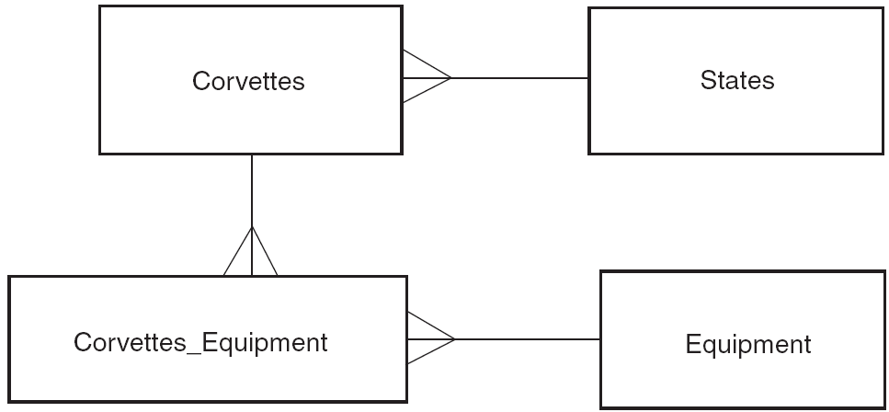
13.1 Logical Data Model for Corvettes DB

Slide 5
13.2 Structured Query Language
SQL is a standardized language for manipulating and querying relational databases
Although relational databases support SQL there may be some minor and some significant differences in the implementations
SQL reserved words are not case sensitive
However, some systems may treat names such as field and table names as case sensitive
SQL commands may have extra white space, including new lines, added to improve readability
Single quotes ( ‘ ) are typically used for literal strings

Slide 6
13.2 The SELECT Command
Used to retrieve records from databases
The command returns a result, a virtual table
SELECT column-names FROM table-names [WHERE condition];
The result table has columns as named
Rows are derived from the table based upon the criteria entered
The WHERE clause is optional
The WHERE clause specifies constraints on the rows selected
If * is used for the column names, all columns are selected

Slide 7
13.2 Joins
Task: list corvettes that have CD players
This involves three tables: Corvettes, Equipment, Corvettes_Equipment
A virtual table is constructed with combinations of rows from the two tables Corvettes and Equipment: a join of the three tables
Or from all combinations of all three tables
The WHERE clause selects which rows of the join are to be retained in the result

Slide 8
13.2 A Query Using a Join
SELECT Corvettes.Vette_id, Corvettes.Body_style, Corvettes.Miles, Corvettes.Year, Corvettes.State, Equipment.Equip
FROM Corvettes, Equipment
WHERE
Corvettes.Vette_id =
Corvettes_Equipment.Vette_id
AND Corvettes_Equipment.Equip_id
= Equipment.Equip_id
AND Equipment.Equip = 'CD';

Slide 9
13.2 A Query Using a Join (alternative)
SELECT Corvettes.Vette_id, Corvettes.Body_style, Corvettes.Miles, Corvettes.Year, Corvettes.State,
Equipment.Equip
FROM Corvettes
LEFT JOIN Corvettes_Equipment ON
Corvettes.Vett_id = Corvettes_Equipment.Vett_id
LEFT JOIN Equipment ON
Corvettes_Equipment.Equip_id = Equipment.Equip_id
WHERE (Equipment.Equip = 'CD‘);

Slide 10
13.2 The INSERT Command
Inserts a new row into a table
Syntax
INSERT INTO table_name (column_name_1,…,column_name_n)
VALUES (value_1,…,value_n);
~or~
INSERT INTO table_name SET column_name_1=value_1,…,Column_name_n=value_n;
The values provided will be placed into the corresponding columns
Columns not specified will receive no value
This will cause an error if the column was created with a NOT NULL constraint

Slide 11
13.2 The UPDATE Command
Changes values in an existing row
Syntax
UPDATE table_name SET column_name_1 = value_1,…,
column_name_n = value_n
WHERE column_name = value
The WHERE clause identifies the row to be updated, probably by its primary key
WARNING: UPDATE queries should almost always include a WHERE clause

Slide 12
13.2 The DELETE Command
Removes one or more rows
Syntax
DELETE FROM table_name
WHERE column_name = value;
The WHERE clause determines which rows are deleted
The sample syntax would probably be specifying a primary key value to identify one row
The clause could be more general
WARNING: DELETE queries should always include a WHERE clause

Slide 13
13.2 The CREATE TABLE Command
Create a table with specified columns, each column having a specified type of data and satisfying certain constraints
Syntax
CREATE TABLEtable_name(
column_name_1 data_type constraints,
...
column_name_n data_type constraints);
Most system support many data types
Common types: INTEGER, REAL, DOUBLE, CHAR(length)

Slide 14
13.2 Create Table Constraints
The constraint NOT NULL causes an error to be raised if a row is inserted in which the corresponding column does not have a value
The PRIMARY KEY constraint causes an error to be raised if a row is inserted in which the corresponding column has a value that equals the value in another row
This can be applied to a group of several columns if the primary key is multi-column

Slide 15
13.3 Client/Server Database Architecture
Two-tier architecture
Client connects to the database to get information
Server or client performs computations and user interactions
Problems with two-tier
Servers getting smaller so client software getting more complex
Keeping clients up to date difficult
Three-tier architecture
Web server with applications sits between a browser and the database system
The web server accesses the database and carries out computations and deals with user interaction

Slide 16
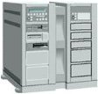
Architecture of Web-based E-Commerce System
Service system
Backend system
Web Server
Application Server
Internet
Database
Firewall
Intranet
(Secure)
Client side
Server side

Slide 17
13.3 Microsoft Access Architectrue
Open Database Connectivity (ODBC)
An application programming interface (API) providing services to interact with a database
One service is to submit SQL to be executed by the database system and to return results
An ODBC driver manager, on the client, chooses the proper interface for a particular database

Slide 18
13.3 The Perl DBI/DBD Architecture
Perl DBI is a module providing generic access to a database system including submitting SQL
Programmers use the DBI in creating software
Perl DBD comprises a variety of modules that interface between the DBI and particular database systems

Slide 19
13.2 PHP and Database Access
There are modules available in PHP to access numerous different database systems

Slide 20
13.3 The Java JDBC Architecture
JDBC is a standard API programmers use to access database systems
Various JDBC drivers are available that interface with particular database systems
A few database systems (HSQLDB and Derby) use JDBC as their native API

Slide 21
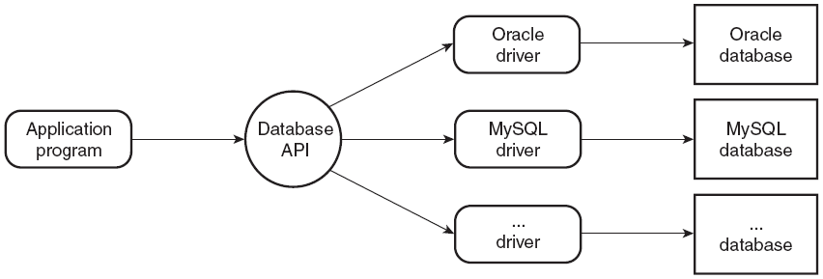
13.3 Database Access Architecture

Slide 22
13.4 The MySQL Database System
Popular free databse system
Most programming language libraries have some interface to MySQL
Logging in to MySQL
mysql [-h host] [-u username] [database_name] [-p]
Starts an interactive shell sending commands the server
host indicates the MySQL server host, defaults to local host
username, if absent, defaults to login user name of the current user
database_name, if present, selects a database for commands
-p indicates a password is needed
Connecting to a database is necessary
Either on the initial command line
use database_name

Slide 23
13.4 MySQL Commands
MySQL supports a large subset of standard SQL
Other commands
CREATE DATABSE database_name;
SHOW TABLES;
DESCRIBE table_name;

Slide 24
13.5 Database Access with Perl and MySQL
Import DBI into the running Perl instance
Load the appropriate DBD module

Slide 25
13.5 The DBI Module
Database handles are used as targets for operations
The handle is an object so a reference is used to access methods
Import the module
use DBI;
Create a database handle
$dbh = DBI->connect( "DBI:driver_name:database_name"
[, username][, password]);
Use with ‘or die’ to handle possible errors

Slide 26
13.5 Submitting Commands with DBI
Convenient to use the prepare method to compile SQL commands
Returns a statement handle
A statement handle supports the execute method
The statement handle then receives the results of the operation
NAME attribute is an array of column names
fetchrow_array returns a reference to the next row of results
Returns false if no further rows

Slide 27
13.5 An Example
The access_cars.pl example allows the user to enter SQL commands and responds with the results
The escapeHTML function is used to replace special characters with HTML entities

Slide 28
13.6 Problems with Special Characters
HTML Characters
Function htmlspecialchars replaces HTML special characters with entities
Special PHP characters
Values from HTTP requests may have characters, such as quotes, that interfere with PHP scripts
Setting magic_quotes_gpc causes values from $_POST, $_GET and $_COOKIE to have backslashes put in front of certain characters
This can cause problems since the backslash is actually part of the string
Must be disabled for the example collecting SQL commands via a web page since the single quote character is important to preserve
mysql_escape_string should be used to prevent special characters from corrupting a query
The stripslashes function removes the extra backslashes from a string

Slide 29
13.6 Connecting to MySQL
The mysql_connect function
First parameter is MySQL server host
Second parameter is the MySQL username
Third parameter is the password
Returns false if it fails
Selecting a database with mysql_select

Slide 30
13.6 Requesting MySQL Operations
The mysql_query function
Takes a string parameter with an SQL query
Returns a result object
Functions that apply to the result object
mysql_num_rows returns number of rows in result
mysql_num_fields returns the number of fields (columns) in the result
mysql_fetch_array returns an array with the next row of results
Each array with a row from the result contains each field value indexed by position and by column name
The array_values applied to this array has each value twice, once for each possible index

Slide 31
13.6 PHP/MySQL Example
The example with carsdata.html and access_cars.php allows users to submit SQL commands that are executed against the Corvette database
The two files could be combined, access_cars2.php
A hidden text field is used to hold a value that tells the script whether the script whether this is an initial request for the page or a second request with values from the form

Slide 32
13.7 JDBC and MySQL
A DriverManager must be available for the database system to which connections are being made
A driver can be assigned to the property jdbc.drivers
The driver class can be referenced in the program
The database is specified by a string of the form
jdbc:subprotocol_name:more_info
The subprotocol name is mysql for MySQL
other_info might include the database name and a query string providing values such as a username or password
A connection object is created
Using the static getConnection method of DriverManager
Getting a connection from a connection pool

Slide 33
13.7 JDBC Queries and Commands
From a connection, create a Statement object
Statement objects support two important methods
Both take an SQL command as a string parameter
executeQuery is for commands that return tabular results, such as SELECT
executeUpdate is for other SQL commands
An executeQuery returns a ResultSet object
The ResultSet object has a cursor pointing to the next row in the result, initially pointing before the first row
The next method moves the cursor to the next row, returns false if there is no next row
Fields from the current result row are obtained with ‘get’ methods, one for each type of data: getString, getInteger for example
The ‘get’ methods take a parameter, either an integer column index or a string column name

Slide 34
13.7 Metadata
Metadata refers to information about a database and its tables, including the virtual tables returned from queries
JDBC supplies methods to retrieve metadata from a database and form a query result
From a database, table names, column names, column types, for example
From a result set, column names and the number of columns, for example

Slide 35
13.7 JDBC Example
The example JDBCServlet.java implements a servlet that collects an SQL query from a user, applies it to the Corvettes database and displays the result

