Slide 1
Chapter 6
Researching Your Subject

Slide 2
Understanding the Differences Between Academic and Workplace Research
In academic research, your goal is to find information that will help you answer a scholarly question.
In workplace research, your goal is to find information that will help you answer a practical question, usually one that involves the organization you work for.

Slide 3
An Overview of the Research Process
Analyze your audience.
Expert, technician, manager, general
Purpose
Why are you writing?
Analyze your subject.
Narrow the topic.
What do you already know? What do you need to find out?
Work out a schedule and a budget.
Visualize the deliverable.
Determine what information will need to be part of that deliverable.

Slide 4
An Overview of the Research Process (cont.)
Determine what information you still need to acquire.
Create questions you need to answer in your deliverable.
Conduct secondary research.
~ then ~
Conduct primary research.
Evaluate your information.
Do more research.

Slide 5
Narrowing a topic
Topic must sufficiently focused to enable you to find useful information.
Techniques:
Examine your own interest in the subject.
Perform secondary research to learn more about the issues. Read books, articles, and Web sites. Then narrow the topic by subject, time, place or event.

Slide 6
Choosing Appropriate Research Methods
What types of research media might you use?
What types of research tools might you use?
What types of primary research might you conduct?

Slide 7
Types of research
Primary Research
Original creation of technical information.
Experiments, investigation, interviews, etc.
Secondary Research
Process of collecting information others have created or discovered.
Do not reinvent the wheel!

Slide 8
Guidelines for Researching a Topic
Be persistent.
Record your data carefully.
Triangulate your research methods.

Slide 9
Secondary Research
Most common sources:
Books, journals, & magazines
Internet
Colleagues
Databases
Conferences, professionals organizations, & seminars
http://lib.siu.edu

Slide 10
Research Media
Print
Online databases
Web sites
Online discussion groups
Personal publications

Slide 11
Basic Research Tools
Online catalogs
Database of books, films, CDs, other materials
Reference works
Guides to the guides
E.g. Walford’s guide to reference materials (Mullay & Schlicke, 1998-2000)
Periodical indexes
Limited subject areas, e.g. by field
Applied Science & Technology Index
Newspaper indexes
Abstract services
Like indexes but with abstracts

Slide 12
Skimming & taking notes
High level skimming to determine if source is NOT useful
Use abstracts if available
Paraphrasing: restating someone else’s words in your own words
Still requires appropriate citation
Quoting: copying someone else’s words, even 2 or 3 in a row, requires quotation marks
Preserve author’s well-expressed phrasing
Lend authority to your discussion

Slide 13
Evaluating Information
Look for information that is
accurate
unbiased
comprehensive
appropriately technical
current
clear

Slide 14
Criteria for Evaluating Print and Online Sources
Authorship
Publishing body
Knowledge of the literature
Accuracy and verifiability of the information
Timeliness

Slide 15
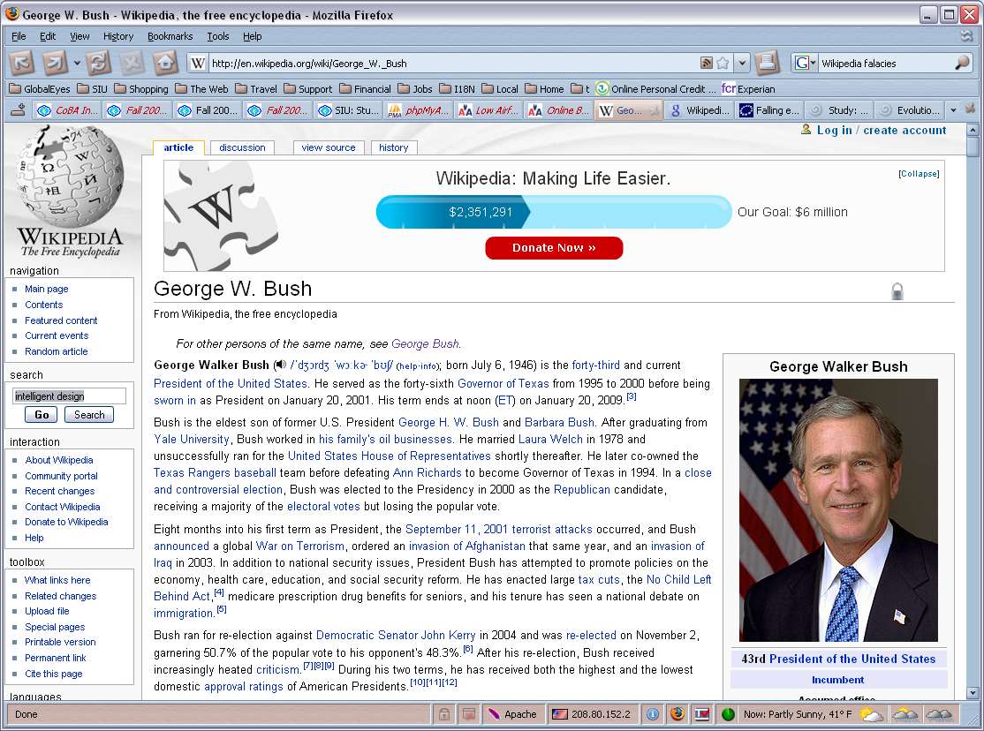
The Wikipedia – Useful or not?

Slide 16
Types of Primary Research
Observations and demos
Inspections
Experiments
Field research
Interviews
Inquiry letters or e-mails
Questionnaires

Slide 17
Four Phases of Conducting an Experiment
Establishing a hypothesis
Testing the hypothesis
Analyzing the data
Reporting the data

Slide 18
Two Common Problems in Field Research
The effect of the experiment on the behavior you are studying
Bias in the recording and analysis of the data

Slide 19
Choosing a Person to Interview
What questions do you want to answer?
Who could provide this information?
Is the person willing to be interviewed?

Slide 20
Preparing for the Interview
Do your homework.
Prepare good questions.
Check your equipment.

Slide 21
Beginning the Interview
Arrive on time.
Thank the respondent.
State the subject and purpose of the interview.
Ask permission to tape the interview.

Slide 22
Conducting the Interview
Take notes.
Start with prepared questions.
Be prepared to ask follow-up questions.
Be prepared to get the interview back on track.

Slide 23
Concluding the Interview
Thank the respondent.
Ask for a follow-up interview.
Ask for permission to quote the respondent.

Slide 24
After the Interview
Write down the important information while the interview is fresh in your mind.
Send a brief thank-you note.

Slide 25
Problems with Questionnaires
Some of the questions will misfire.
You won’t obtain as many responses as you want.
You cannot be sure the respondents are representative.

Slide 26
Common Types of Questions
Multiple choice
Likert-type scale
Semantic differentials
Ranking
Short answer
Short essay

