Slide 1
Chapter 17
Writing Informal Reports

Slide 2
Informal reports can take many forms:
E-mails
Easy to distribute
Memos
Relatively informal and used to communicate to people within the same organization (1-10 pages)
Forms
Pre-printed forms or computer templates
Letters
Preferred when at different organizations
Reports
May require transmittal letters, title pages, and TOC

Slide 3
Writing Process for Informal Reports
Analyze your audience.
Analyze your purpose.
Research the subject and compile your information.
Choose an appropriate format.
Draft the report.
Revise, edit, and proofread the report.

Slide 4
Types of Informal Reports
Directives
Explain a policy or procedure
Field and lab reports
Describe inspections, maintenance, and site studies
Progress and status reports
Describes an ongoing project or the entire range or operations of a department
Incident reports
Describes events such as workplace accidents, health or safety emergencies, and equipment problems
Meeting minutes
An organization’s official record of a meeting

Slide 5
Directives
Explains a policy or procedure
Provides background or reason for directive
Why the policy is desirable or necessary
Present yourself as cooperative, moderate, fair-minded and modest
Ex. Page 436

Slide 6
Field and Lab Reports
Describe inspections, maintenance, and site studies
Explain the problem, methods, results, and conclusions
Deemphasize methods
Can include recommendations
Ex. Page 437

Slide 7
Questions to Answer in a Field or Lab Report
What is the purpose of the report?
What are the main points covered in the report?
What were the problems leading to the decision to perform the procedure?
What methods were used?
What were the results?
What do the results mean?
What should be done next?

Slide 8
Progress and Status Reports
A progress report describes an ongoing project.
A status report or activity report describes the entire range of operations of a department or division.
Ex. Page 441

Slide 9
Report honestly!
Avoid overstating results
Explain unanticipated problems
Be honest in responding to common problems:
The deliverable won’t be what you thought it would be.
You won’t meet your schedule.
You won’t meet the budget.

Slide 10
Organizational Patterns in Progress and Status Reports
Time Pattern Task Pattern
Discussion Discussion
A. Past Work A. Task 1
B. Future Work 1. Past Work
2. Future Work
B. Task 2
1. Past Work
2. Future Work

Slide 11
Projecting an Appropriate Tone in a Progress or Status Report
If the news is good, convey your optimism but avoid overstatement.
Don’t panic if the preliminary results are not as promising as you had planned or if the project is behind schedule.

Slide 12
Writing Incident Reports
Briefly summarize the accident.
Present background information.
Present your main conclusion about what caused the accident.
Explain the root cause of the accident.
State your recommendations.
Ex. Page 448

Slide 13
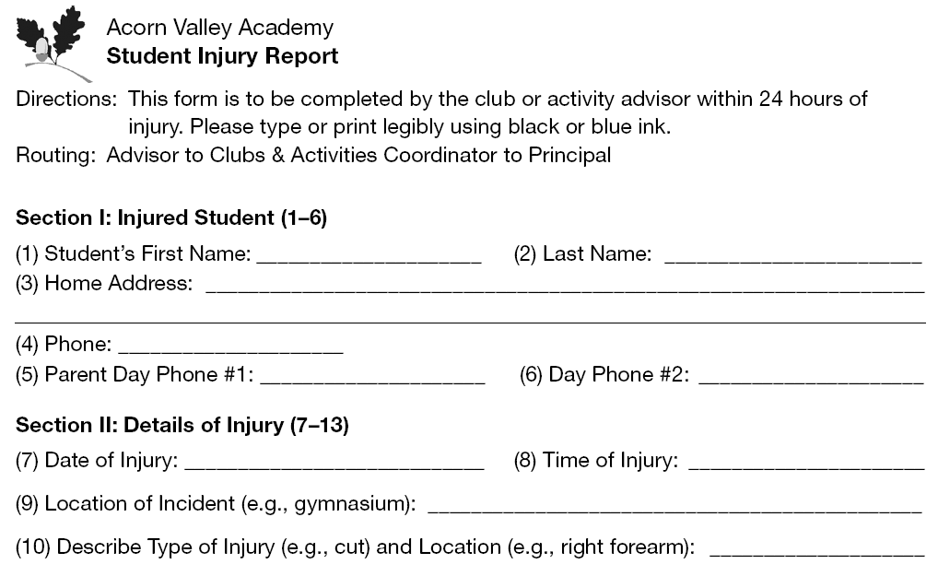
Sample Incident Report

Slide 14
Writing Meeting Minutes
Record the logistical details of the meeting.
Record the purpose of the meeting.
Record the action taken at the meeting.
Be objective; do not interpret events.
What happened, not why it happened
Do not record emotional exchanges between participants.
Distribute the minutes to all participants of the meeting and other interested parties.
Ex. Page 449

